Slide 1
WELCOME TO THE WUST LIBRARIES

Slide 2
All WUST students are welcome to our campus
libraries. Here you can find a wide selection of
books, as well as digital resources such
e-books, e-journals, databases, and other online
materials.
We also offer you trainings, individual study
rooms and exhibitions.
Our friendly staff are here for you - both digitally
and physically.

Slide 3
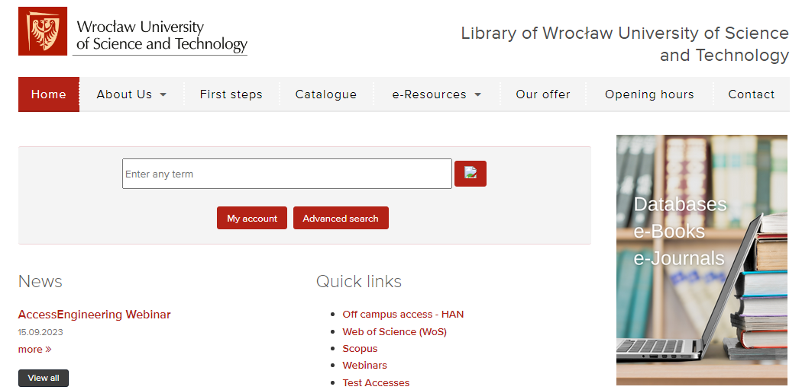
OUR WEBSITE
http://biblioteka.pwr.edu.pl/en

Slide 4
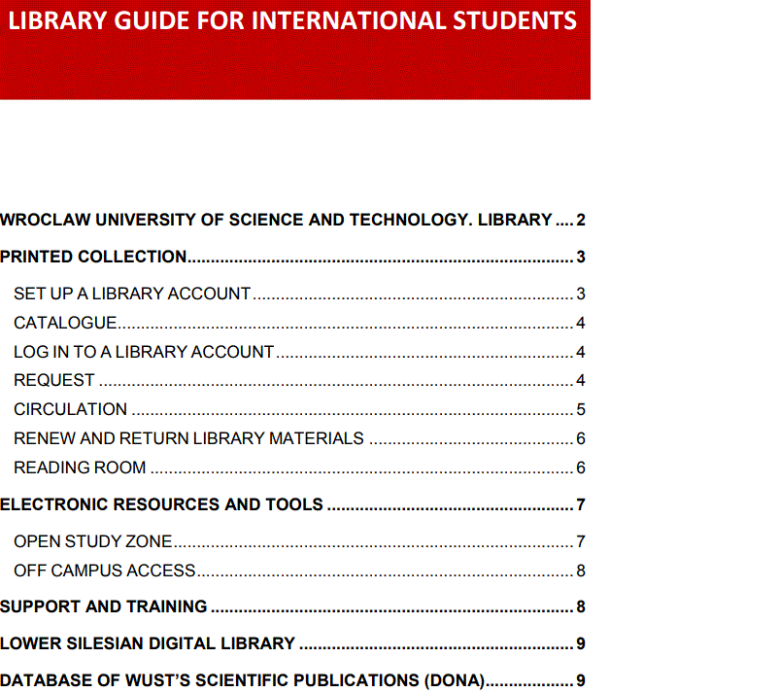
DETAILED GUIDE HOW TO USE THE LIBRARY
https://biblioteka.pwr.edu.pl/en/first-steps

Slide 5
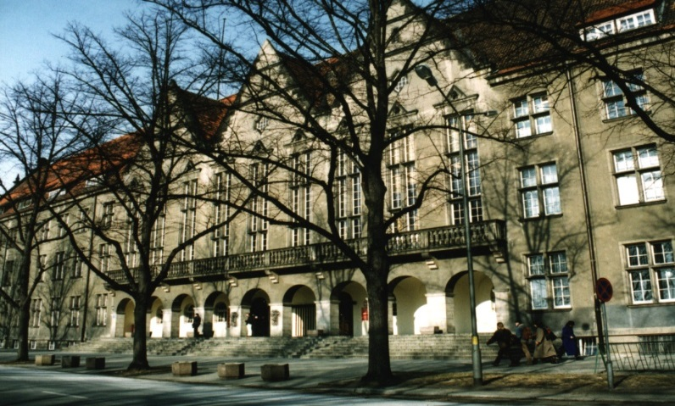
LIBRARIES - LOCATION
Library- Building - A1
Student library services:
our students can get access to many resources wherever they are working or studying.
here: printed books and journals

Slide 6
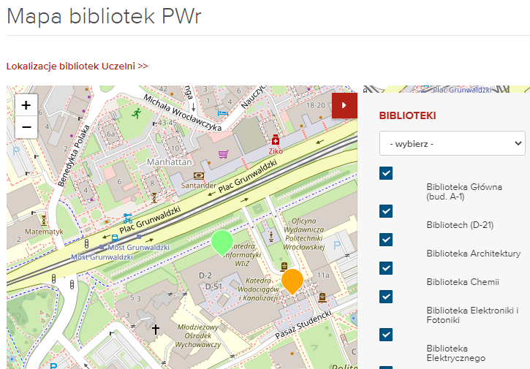
BRANCH LIBRARIES AT FACULTIES
Location

Slide 7
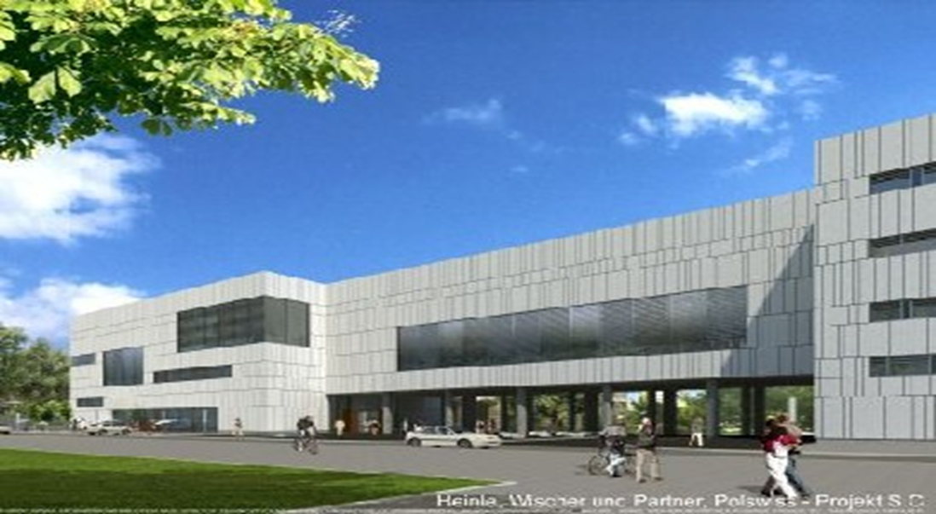
OPEN STUDY ZONE
Building - D21

Slide 8

USER REGISTRATION
ON - SITE
Building A-1 room 307
Needed document - Student ID

Slide 9

REMOTELY
blioteka.wyp@pwr.edu.pl
Please send a scan of the documents to the address:
biblioteka.wyp@pwr.edu.pl
You will receive an email back informing you that your account has been activated.
Filled registration form
available here :
http://biblioteka.pwr.edu.pl/en/first-steps
(How to register to a library.pdf)
Student ID (both sides)

Slide 10
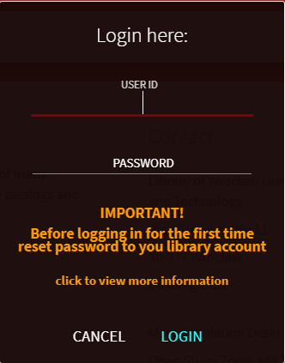
HOW TO USE THE LIBRARY SYSTEM ?
LOG IN TO PRIMO VE
To use the Library you have to log in to the PRIMO VE search engine. Before the first logging you have to reset your password to your library account.
Follow the steps:
  Choose : reset password to your library account
  username:
  student ID numer or
  first name. family name or
  e-mail registered in a library
  You will receive an e-mail with a link to reset your password. Click the link and enter a new password.

Slide 11
OUR OFFER
- Electronic resources:
Databases
Electronic books and journals
- Lower Silesia Digital Library
- Printed books and journals, standards
….and many others

Slide 12
LOANS
6 months
10 books
in every library
3
days to collect

Slide 13
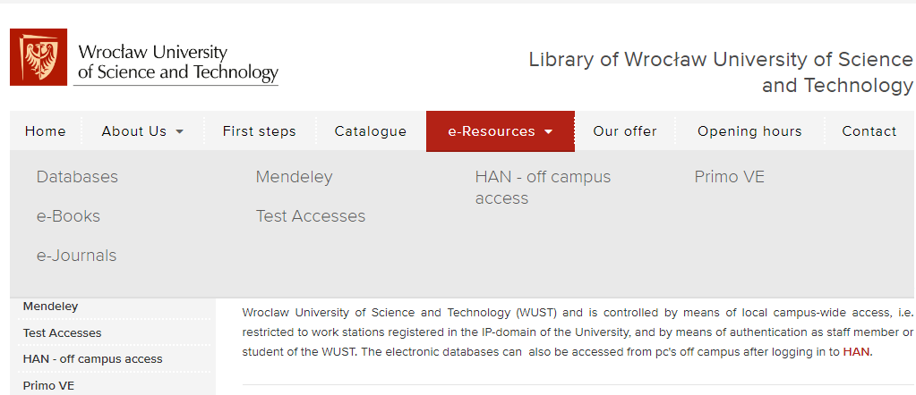
ELECTRONIC RESOURCES

Slide 14
EDUROAM.PWR.EDU.PL
Login and password for eduroam network are the same as for Active Directory (AD) system
Please note that this is not the login and password for Gmail
General information you can find here: https://cat.eduroam.org/

Slide 15
REQUEST A SCAN FROM THE LIBRARY
All persons with an active library account can request a scan of the materials available in the reading room.
Journal articles as well as excerpts from books, e.g. individual chapters, can be ordered.
The daily order limit for one user is 5 orders in all libraries.
The order limit per book cannot exceed 20% of the total (the limit is renewed after 6 months).
Orders will be processed on a first-come, first-served basis.
It is possible to adapt scans for visually impaired and blind users. Such a request should be entered in the "Notes" field when placing the order.
All details here: http://biblioteka.pwr.edu.pl/en/our-offer

Slide 16
FICTION FOR PLEASURE
- WUST students have a wide access to a fiction collection in different languages and on different levels in a:
Fiction Library (only Polish literature) building A-1 room 308
branch library of the Department of Foreign Languages.
building H-4
Municipal Public Libray ( Biblioteka Miejska)
https://biblioteka.wroc.pl/en/about-us/terms-and-conditions/
-
Registration
Citizens of other countries have to submit passport or another
document with a photograph, fill out the commitment card and sign
accepted rules
-

Slide 17
OPEN STUDY ZONE-INSIDE
You can use open space to study

Slide 18
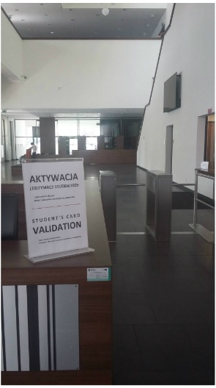
OPEN STUDY ZONE
    Security Gates in D21
    please use your student ID and the link to register:
    skd.pwr.edu.pl (on site)

Slide 19
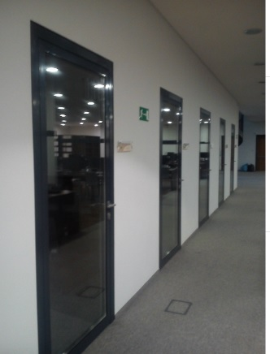
INDIVIDUAL STUDY ROOMS
1st and 2nd floor

Slide 20
INDIVIDUAL STUDY ROOMS
To use an Individual Study Room, you must have an active library account and report with your ID to the librarian on duty on the first floor of the Open Study Zone
Rooms are available during the opening hours of the Open Study Zone
Maximum two people can stay in a room

Slide 21
NEW VPN SERVICE
New VPN service for the students to be launched on 1 October
In order to use the new VPN, it is necessary to install the application Palo Alto GlobalProtect application
Available for download from the website vpn.student.pwr.edu.pl
Use the authentication through ActiveDirectory (the same data as for logging in to the USOS service)

Slide 22
HAN - OFF CAMPUS ACCESS
Using HAN you can connect to the WUST network and access library resourses from any place you stay in.
- To be able to use the HAN system, an active account in
ACTIVE DIRECTORY system is obligatory
Login details:
Active Directory login e.g. ( xxxyyy1234)
Individual user password set in the Active Directory
If you have problems accessing e-resources via the HAN system, please send e-mail: han@pwr.edu.pl
https://biblioteka.pwr.edu.pl/en/e-resources/han---off-campus-access

Slide 23
HELPFUL E-MAILS
Problems with authentification and Active Directory help+ad@pwr.edu.pl
- Problems with your library account
biblioteka.wyp@pwr.edu.pl
- Problems with remote access to e-resources
han@pwr.edu.pl

Slide 24
INDIVIDUAL WORKSHOPS AND TRAININGS
How to locate the library resources
efficiently and effectively
How to find a relevant database,
e-journals, e-books or other resources
How to connect off campus
Need help? Please send an email
infnauk@pwr.edu.pl

Slide 25
QUESTIONS
Library
Building D21; room 104
Jolanta.Wrobel@pwr.edu.pl

