Slide 1
Erasmus+ 2024/2025
– Information meeting for pre-qualified students Wrocław March, 22 2024

Slide 2
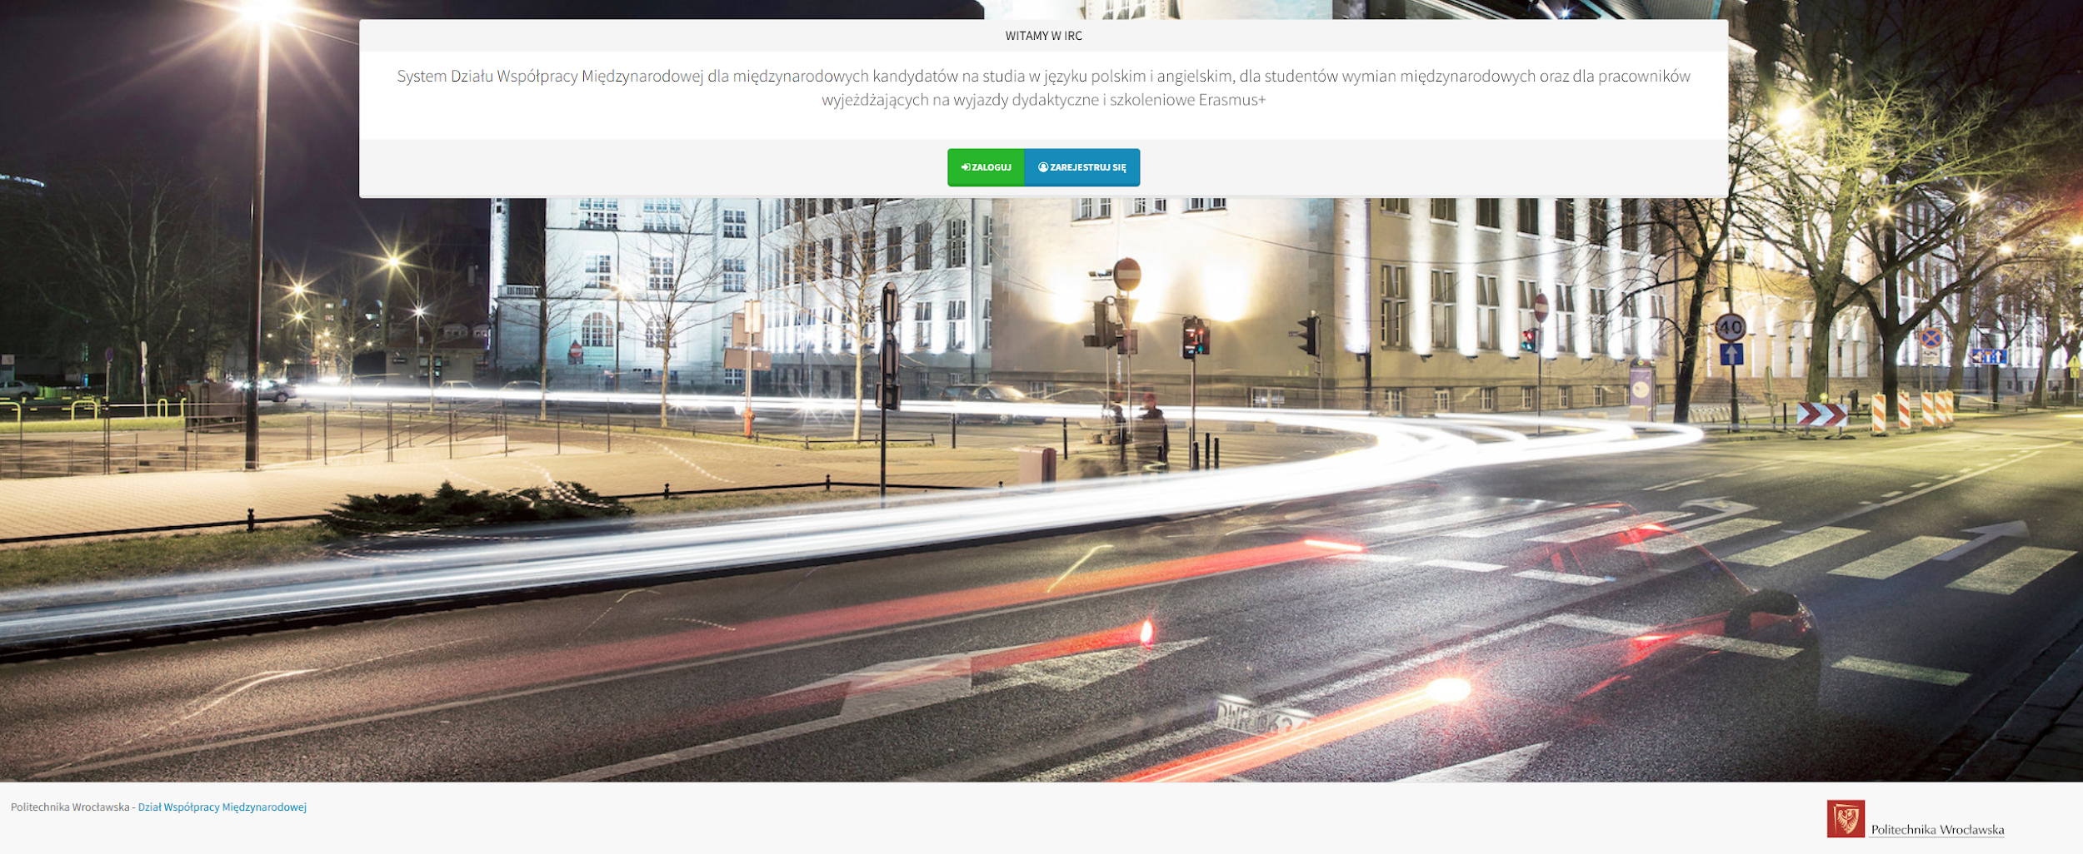
II stage of recruitment –application in the IRC system
1 STEP –obligatory registration in the IRC system
After receiving an automatic email form the system, log in to www.registration.pwr.edu.pl and fill in your personal data
Then go to „application” and fill in the data according to the instructions from the TO-DO list .
ATTENTION! Deadline for registration in the IRC system is April 8

Slide 3
Application documents - part 2
Application Form with the photo
Learning Agreement signed by the student and WUST Faculty Coordinator
Deadline April 24 (exchange in the winter and all-year) w semestrze zimowym i na cały rok), May 17 maja (exchange in the summer semester)
Documents to be downloaded from the IRC system
Certificate of language competence:
a) Student who took the language exam at SJO 09.03.2024 should take a certificate of the exam result
b) Student exempt from the language exam: a copy of photocopy of the language certificate or the printout of a page from the electronic index with the course grade signed by the Dean’s Office or a scan of the language pass certificate from SJO, uploaded to IRC
IMPORTANT! The final qualification for the Erasmus+ Programme is determined by the acceptance of the receiving university

Slide 4
Application documents for the Receiving University – check the deadline for submitting an application
After nomination to the host University, you will receive a massage with information about acceptance and information about next steps from the PARTNER UNIVERSITY
All documents required by the partner university (e.g. photos, photocopy of passport/ID card, application
If the Partner University requires it – student sends a full application scan via email
If the Partner University requires it – student fills application online on the partner’s website
The student sends complete set of required documents by himself
Please make sure that the documents have reached the Partner University
Checking email regularly (including the student mailbox and SPAM folder)
Acceptance form the Partner University will be send to the student’s e-mail address
IMPORTANT! The student should check the deadline for the nomination and the deadline for sending in the application to the Partner University
ATTENTION! The student informs IRO that the university has received his application

Slide 5
STUDENTS ON THE RESERVE LIST
Students on the reserve list do not register in the IRC system and do not send online applications to the Partner University
If a place becomes available, the Faculty Coordinator will contact the student from the reserve list and inform IRO about it
If a place becomes available, a student from the reserve list may apply only to the University to which he was assigned by the Faculty Coordinator
Students form the main list are obligated to inform IRO and the Partner University about their resignation from the exchange as soon as possible so as not to block places for other students..

Slide 6
What to do after acceptance by after the foreign university?
Documents required to sign the Financial Agreement before departure:
Application Form signed by the student
The Dean’s Consent (the temple will be available in IRC after completing all data)
Learning Agreement (from the OLA system or form the IRC signed by the student, WUST’s Faculty Coordinator and Coordinator from Receiving University
Personal data declaration – with confirmation of the EURO account number in a Polish bank (no REVOLUT)
Acceptance Letter – a letter confirming admission to studies at a Partner University
Confirmation of language competence at least B2.2 level
A copy of the Decision on entitlement to a social scholarship or disability certificate (if applicable)
Private insurance (cover medical and accident costs)
Copy of a EKUZ card
Information about Previous mobilities (applies to everyone)
The Financial Agreement in 3 copies
The documents necessary to sign the Financing Agreement should be delivered at the earliest 1 month and at the latest 2 weeks before departure.

Slide 7
ERASMUS APP
The Erasmus+ - Erasmus App is part of the European student ID card initiative. It was developed by the European Commission to enable the digitization of administrative procedures for student mobility and to simplify them.
The Erasmus+ app will guide you through the various stages of your mobility and enable you to find all the information and services that will make your exchange trip more enriching and smooth.
In the public news channel you will find tips and reports from other participants, as well as events and offers from student organizations.

Slide 8
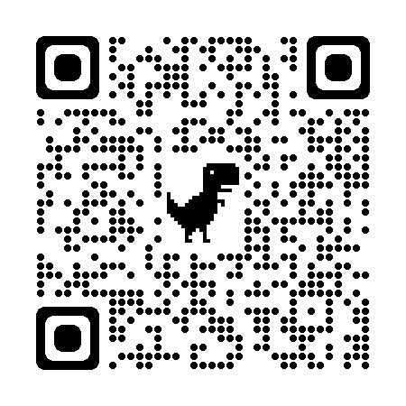
OLS– Online Linguistic Support
All Erasmus+ (study away) users have the opportunity to complete a language proficiency test prior to mobility and participate in online language courses available on the OLS platform
Erasmus+ students going abroad can use the OLS system to assess their knowledge of the language they will use during their studies and access a personalized language learning path

Slide 9
Amount of funding (studies)*
Study mobilities: from 2 to 12 months
Countries in the group | Monthly scholarship rate in EURO *
Group 1 – Denmark, Finland, Iceland, Ireland, Liechtenstein, Luxembourg, Norway, Sweden, region 14* | 670 €
Group 2 - Austria, Belgium, Cyprus, France, Greece, Spain, Malta, The Netherlands, Germany, Portugal, Italy, region 13* | 670 €
Group 3 – Bulgaria, Croatia, Czech Republic, Estonia, North Macedonia, Latvia, Lithuania, Romania, Serbia, Slovakia, Slovenia, Turkey, Hungary | 600 €
The grant is paid in two tranches:
1st tranche - 80% before departure,
II tranche - 20% after return and delivery of necessary documents for settlement. It is paid on the basis of actual dates of physical mobility.
Rates are subject to change*.

Slide 10
„Green Travel”
▪When travelling with environmentally friendly means of transport (bus, train, carpooling, bicycle)
▪Individual support for living expenses - possible for 4 additional days of travel
▪EUR 50 for meeting the requirements related to „green travel”
NOTE: travel days cannot take place during the mobility period

Slide 11
Other funding opportunities
Additional scholarships from the Wroclaw City Council-information on the website of the Wroclaw Academic Center
Subsidies for persons with a certified degree of disability on the basis of an application submitted to the DWM no later than one month before the planned trip - settlement according to actual costs, which means the need to document expenses with financial evidence (invoices, bills, tickets)
NOTE!
Scholarship recipients who are eligible for social allowance during the current recruitment process
or those with a disability certificate will be fully financed
from the Erasmus+ program along with an additional EUR 250/month of stay.
The student must provide a copy of the decision on eligibility for a social allowance together with the application submitted to the IRO.

Slide 12
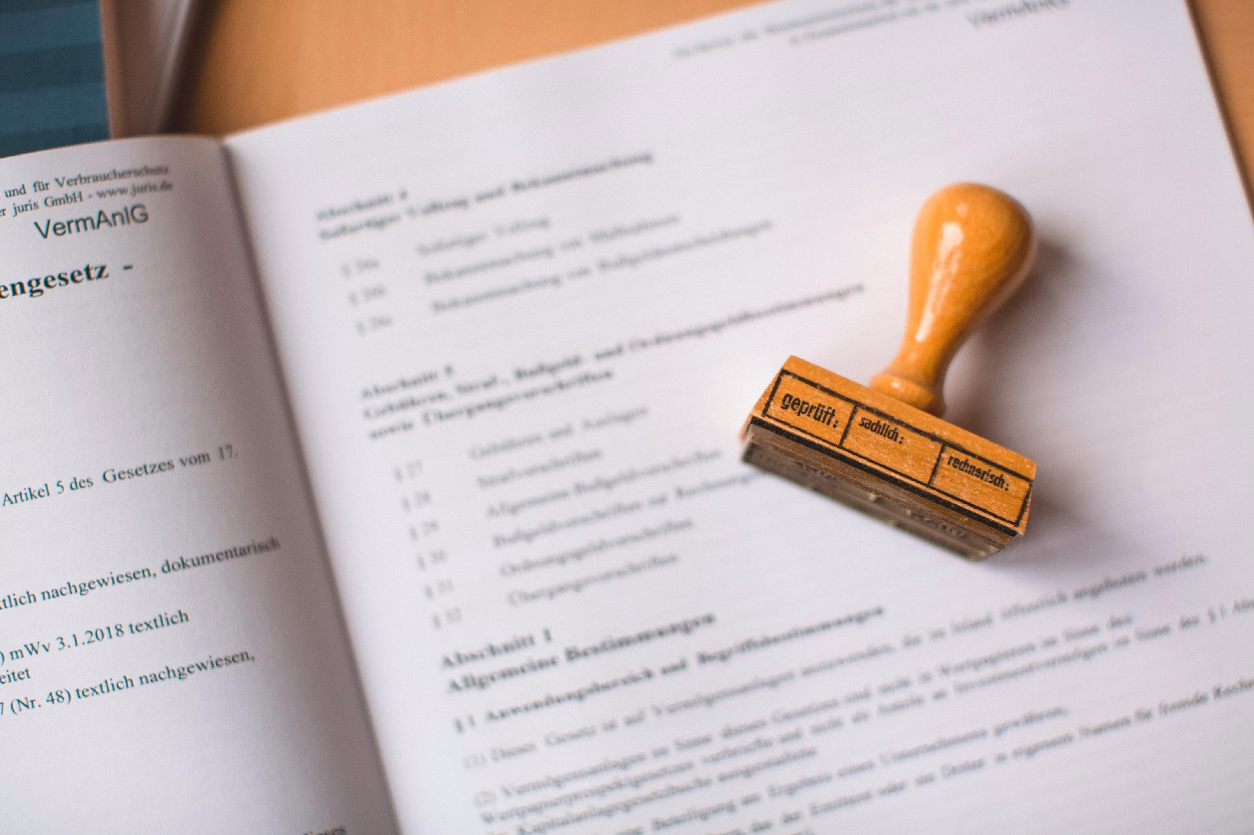
While at the Host University
In the case of changes to the program of study-the Section to be completed DURING THE MOBILITY (Changes to Learning Agreement)-must be signed by:
Student
Representatives of the partner university and the Faculty Coordinator
Possibility to extend the stay –The extension procedure is announced in late October/early November. Funding for the extension is limited by available funds (not always guaranteed), once the deadline has passed, there will be no possibility of extension
Students in their final semester cannot extend their stay
Possibility of shortening the stay (application to IRO, need to return the undue part of the grant)
Contact with IRO (email, phone), reporting difficulties, problems, etc.

Slide 13
After returning from the exchange
SUBMISSION OF DOCUMENTS IN IRO:
Section to be completed AFTER THE MOBILITY - RECOGNITION DOCUMENT (Transcript of Records) -the list of credits with grades and ECTS points, signed and stamped by the partner university, as well as the recognition part -tab. F of the Learning Agreement, signed by the Faculty Coordinator from WUST
Certificate of Stay - confirming the stay at the university with exact dates of stay on the university's paper
Learning Agreement and Changes (if there were any changes)
Filling out the grantee questionnaire Erasmus+ Programme - an automatic message with a link to the survey arrives in the mail on the last day of mobility
ALL DOCUMENTS MUST BE SUBMITTED to the IRO and attached to the IRC.
THIS IS A PREREQUISITE FOR THE DISBURSEMENT OF THE LAST TRANCHE OF THE GRANT.
FACULTY CLEARANCE (recognition for the student's achievements of the courses completed at the partner university) -meritically from the completed program the student is accounted for at the faculty

Slide 14
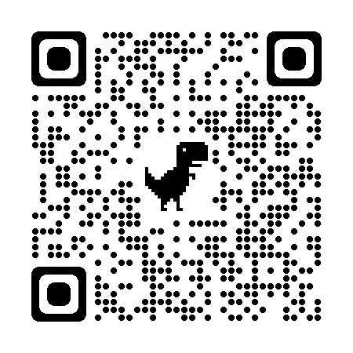
International Relations Office
Anastasiia Bokovenko
e-mail: anastasiia.bokovenko@pwr.edu.pl
phone no: 71 320 22 32
Joanna Latuszek
e-mail: joanna.latuszek@pwr.edu.pl
phone no.:71 320 25 43
Julia Bohdziewicz
Erasmus+ Institutional Coordinator
e-mail: julia.bohdziewicz@pwr.ed.pl
12 Na Grobli Street
Building L-3, 1st floor
Wroclaw, 50-412
Office hour for students:
Monday -Friday 8:00 –14:00

Slide 15
Thank you for your attention

