Slide 1
Legalization of the student’s stay in the territory of the Republic of Poland

Slide 2
Introduction
General principles and conditions
Indications from the practice
Questions

Slide 3
Where and when submit the application
The foreigner makes the application personally, no later than on the last day of the lawful residence on the territory of the Republic of Poland to the voivode competent with regard to the foreigner’s place of residence.
During making the application the foreigner is under obligation to give his/her fingerprints.
Fees related to residence permit:
340 PLN
Fee for residence card 50 PLN -> as a student you are entitled to a reduction in the fee for issuing a residence card in the amount of PLN 25.
Necessary documents:
Completed form of the application for temporary residence permit,
4 up-to-date photographs;
Photocopy of a valid travel document (original available for inspection), in particularly justified case if the foreigner does not have a valid travel document and it is not possible to obtain such document, may present another document which confirms his/her identity.

Slide 4
Due to the fact that the foreigner is under obligation to give his/her fingerprints, you have to come to the office personally.
Even if you send your application via post you will be asked to visit the office ( in Wrocław, Jelenia Góra, Wałbrzych
or Legnica)
Lack of any of the aforementioned documents will result
in margin call within 7 days from its delivery, under pain of leaving the application without examination.

Slide 5
Residential status following the application
If the application for temporary residence permit was made during the foreigner’s lawful residence and this application did not contain formal defects or these defects were supplemented within the time limit, the voivode stamps the travel document which confirms registration of the application.
Residence of the foreigner is deemed to be legal from the date of submission the application until the date when the decision on temporary residence permit becomes final.
Note: Stamp in the travel document does not entitle the foreigner to travel through territories of other countries of Schengen area, while the foreigner may travel to the country of origin, however, in order to return to Poland he/she must obtain a visa, if he/she comes from the country which is subject to the visa obligation.

Slide 6
When you can apply?
If a foreigner intends to
1. undertake or continue full-time studies or full-time doctoral studies:
first degree studies,
second degree studies,
uniform Master’s studies
third degree studies
2. to attend a preparatory course which is to enable him/her to undertake full-time studies

Slide 7
CONDITIONS
the foreigner submits:
a document issued by the relevant higher education institution certifying that the foreigner has been admitted to studies run by it for the purposes of undertaking such studies or their continuation
a proof of payment of the fee where the foreigner undertakes or continues paid studies

Slide 8
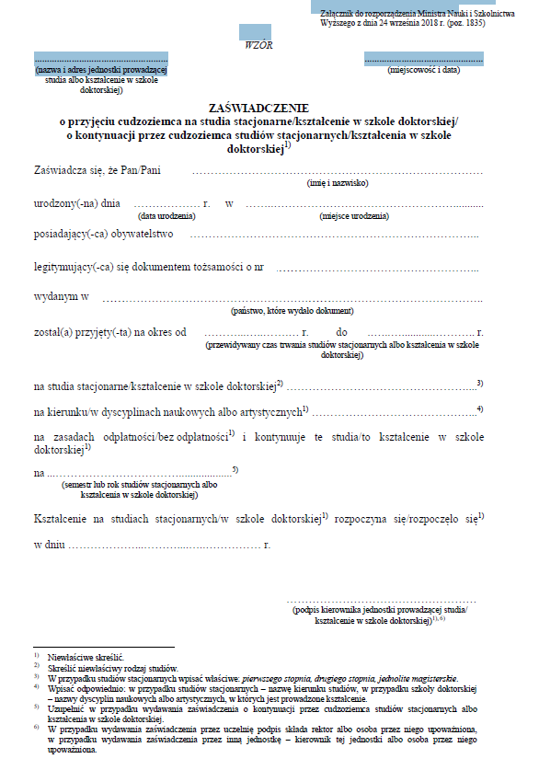

Slide 9
health insurance or a document certifying that the costs of treatment in the territory of the Republic of Poland will be covered by the insurer,
financial means sufficient to cover the costs of subsistence and return to the country of origin or residence, or the costs of transit to a third-country that will grant the foreigner a permit for entry, as well as tuition fees

Slide 10
Financial means are:
1) traveller's check,
2) a certificate of the limit on the credit card issued by the bank that issued the credit card;
3) certificate of having cash at the bank having registered office in the territory of the Republic of Poland; → the most popular,
4) document that confirms the granting of
a national or foreign scholarship;
5) ONLY if you apply second,third, etc. time ->certificate of employment and amount of earnings

Slide 11
702 PLN / month
and…
money to cost the return ticket to the country you come from or the ticket

Slide 12
Cost of the return ticket:
200 PLN if you came from the neighbouring countries of Poland
500 PLN if you came from a Member State of the European Union not neighboring with the Republic of Poland or from a Member State of the European Free Trade Agreement (EFTA) - parties to the European Agreement Economic Area or from the Swiss Confederation
2 500 PLN, if you came from county other than those specifed above

Slide 13
A foreigner shall be refused the permit if the foreigner:
1. he/she does not meet the requirements for being granted a temporary residence permit due to the declared purpose of the stay or the grounds for applying for such a permit do not justify his/her stay in the territory of the Republic of Poland for a period longer than 3 months, or
(2) his/her data has been entered in the register of foreigners whose stay in the territory of the Republic of Poland is undesirable, or
(3) his/her data is entered in the Schengen Information System for the purposes of refusing entry, or
(4) it is justified by national security or defence, or by the protection of public safety and order, or
(5) in the course of the proceedings on granting him/her a temporary residence permit, the foreigner:
(a) filed an application containing false personal data or false information or attached documents containing such data or information to the application, or
(b) testified untruthfully or concealed the truth, or forged or modified a document in order to use it as an authentic one, or used such a document as an authentic one, or

Slide 14
A foreigner shall be refused the permit if the foreigner:
(8) is subject to the treatment obligation pursuant to Article 40(1) of the Act of 5 December 2008 on the prevention and control of infections and infectious diseases in humans but does not express consent for such treatment, or
(9) has filed the application during an illegal stay in the territory of the Republic of Poland or is staying in this territory illegally
(*) as the long-term resident from one of EU’s country holds a temporary residence permit in Poland for the purposes of undertaking or continuing studies or vocational training
(*)performs work or conducts business activity in the territory of the Republic of Poland, unless he/she is applying for a further permit

Slide 15
How long?
The first permit shall be granted for a period of 15 months
Where the reason for applying for the permit justifies the foreigner’s stay in the territory of the Republic of Poland for a period shorter than 1 year, the first permit shall be granted for the period of the duration of the academic year or studies, extended by 3 months.
The next permit shall be granted for the period of duration of the academic year or studies, extended by 3 months but not longer than 3 years.
The permit referred to a preparatory course shall be granted for the period of the duration this course extended by 3 months.

Slide 16
When you get the positive decision :
The foreigner who obtains temporary residence permit on the territory of Poland will be issued with the residence card. This document is issued ex officio by the voivode who granted the residence permit.
Residence card in the period of its validity confirms the foreigner’s identity during his/her residence on the territory of the Republic of Poland and entitles him/her, along with the travel document, to multiple crossing of the border without the need to obtain the visa.

Slide 17
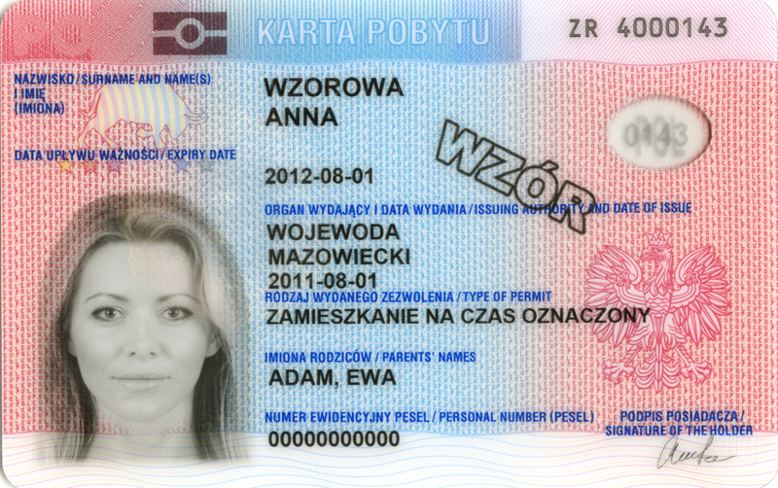
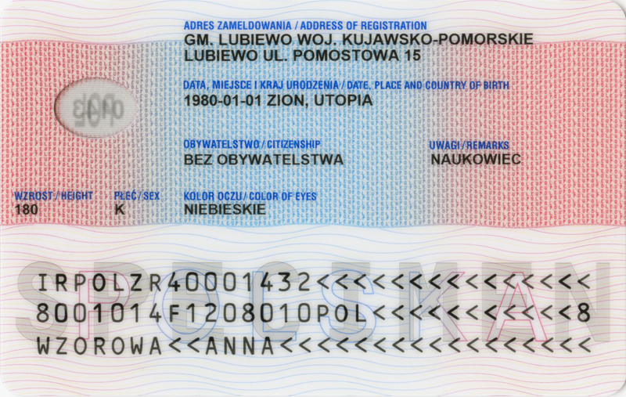

Slide 18
Entitlement to work
After obtaining this permit, a foreigner may perform work in Poland without the need to have a work permit. The residence card, issued in connection with temporary residence permit, includes a note “access to the labour market”.

Slide 19
Foreigners who study in different form than full-time studies
additional things: the document which confirms place of residence in Poland
from 3 months till one year
entitlement to work - This permit does not grant to the foreigner the right of access to Polish labour market. The employment is possible on general terms, provided that the foreigner have the worker permit, unless it is not required.

Slide 20
Tips
read the instruction before you start to fill application and follow the instruction
the application should be completed legibly, in printed letters written into the appropriate boxes
don’t forget to inform us about changing your address
don’t forget to translate in Polish language all documents which you want to attach to your application
if you want to meet with your inspector make first the appointment with the supervisor of your inspector

Slide 21
Questions

Slide 22
Working hours: Monday, Tuesday, Thursday and Friday: 9.00 a.m. – 4.00 p.m. Wednesday: 8.00 a.m. - 6.00 p.m. Dolnośląski Urząd Wojewódzki Wydział Spraw Obywatelskich i Cudzoziemców (Department of Civil Affairs and Foreigners) www.duw.pl Plac Powstańców Warszawy 1, 50-153 Wrocław ul. Piłsudskiego 12, 58-500 Jelenia Góra ul. F. Skarbka 3, 59-220 Legnica ul. Słowackiego 23a, 58-300 Wałbrzych

