Slide 1
Dormitories at Wroclaw University of Science and Technology

Slide 2
What should I take to dormitory ?
- bedding linen, duvet, pillow; - kitchenware (dishes, pots, cutlery);

Slide 3
Who to contact ?
Dormitory Manager
Dormitories Reception (T15, T22)
Student Information Office
International Relations Office

Slide 4
Remember to:
read Rules and Regulations of Dormitories at Wroclaw University of Science and Technology
it is not possible to change the dormitory and room after checking in
pay the deposit
sign your individual contract
pay fee for a place in a dormitory till 15th of each month
clean your room and common area you use
segregate and throw rubbish outside a building in designated areas
respect your surroundings and neighbors, especially after the night quiet hours (23:00 – 7:00)
keep your thing inside your room (e.g shoes, clothes dryers, rubbish)
remember to always lock the doors when you are leaving your room
or residential module

Slide 5
If you can’t pay the deposit when checking in :
Account number: 03 1090 2402 0000 0001 3128 5288
Transfer title should contain following information: Name and surname, student ID number, dormitory number.
If you transfer the deposit, please take the confirmation of the payment with you and present it to the manager of the dormitory upon check-in.

Slide 6
Remember:
smoking cigarettes inside the dormitory is forbidden, penalty for covering gas detectors is 240 zł
do not leave anything unprotected on the gas stove - it triggers detectors and an alarm– an unjustified call to the firebrigade is a fine up to 1000 zł
you will need LAN cable
check your student email account (https://s.student.pwr.edu.pl/)
there are no storage units at the dormitories- when you leave (check out) you need to take all your belongings with you

Slide 7
Registration of Temporary residence :
- there is an obligation in Poland of registration of Temporary residence.
- to register your Temporary residence, please report to the City Hall with the temporary residence application form.
-You will recive residence application form in your dormitory
- this obligation applies not only to student staying at Dormitories

Slide 8
All students planning to stay in Student Dormitories are required to read and follow these rules.
Provisions regulating the functioning of WUST dormitories and guest rooms in connection with counteracting SARS-CoV-2 spread.
Procedure for accommodation in dormitories of Wrocław University of Science and Technology – PDF.
Operating procedure in case of suspected SARS-CoV-2 infection in wust dormitories – PDF.
(documents available at website https://prs.pwr.edu.pl/)

Slide 9
Remember to apply for dormitory for next academic year via Edukacja.CL system!
Detailed information will be published at website https://prs.pwr.edu.pl/

Slide 10
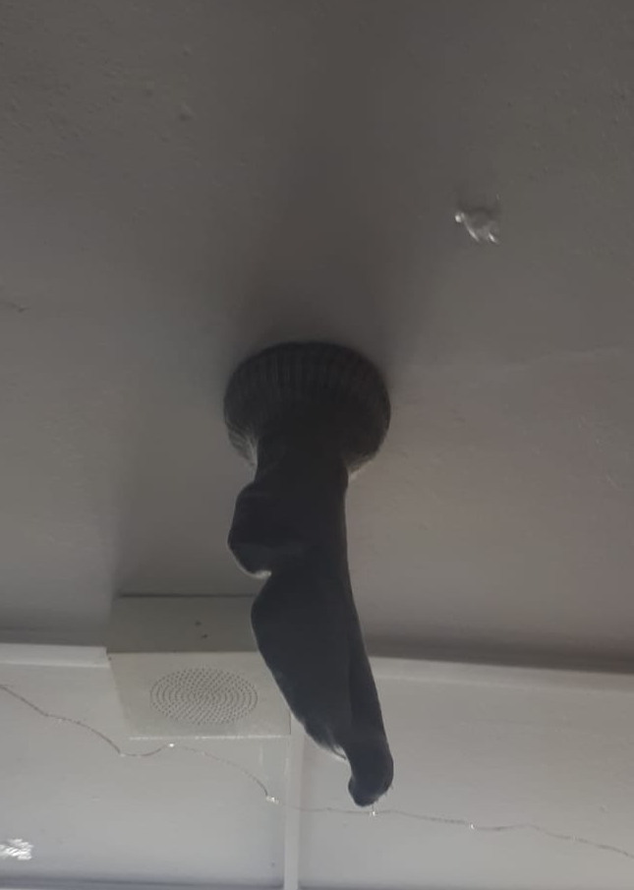
During accommodation, remember not to do
this – you can lose 240 zł from your deposit

Slide 11
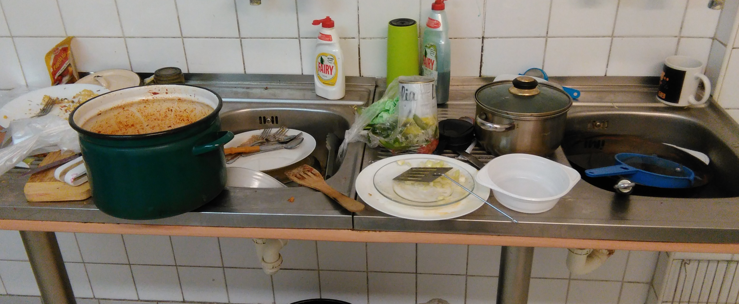
and this …
– abandoned dirty kitchenware will be thrown out!!!

Slide 12
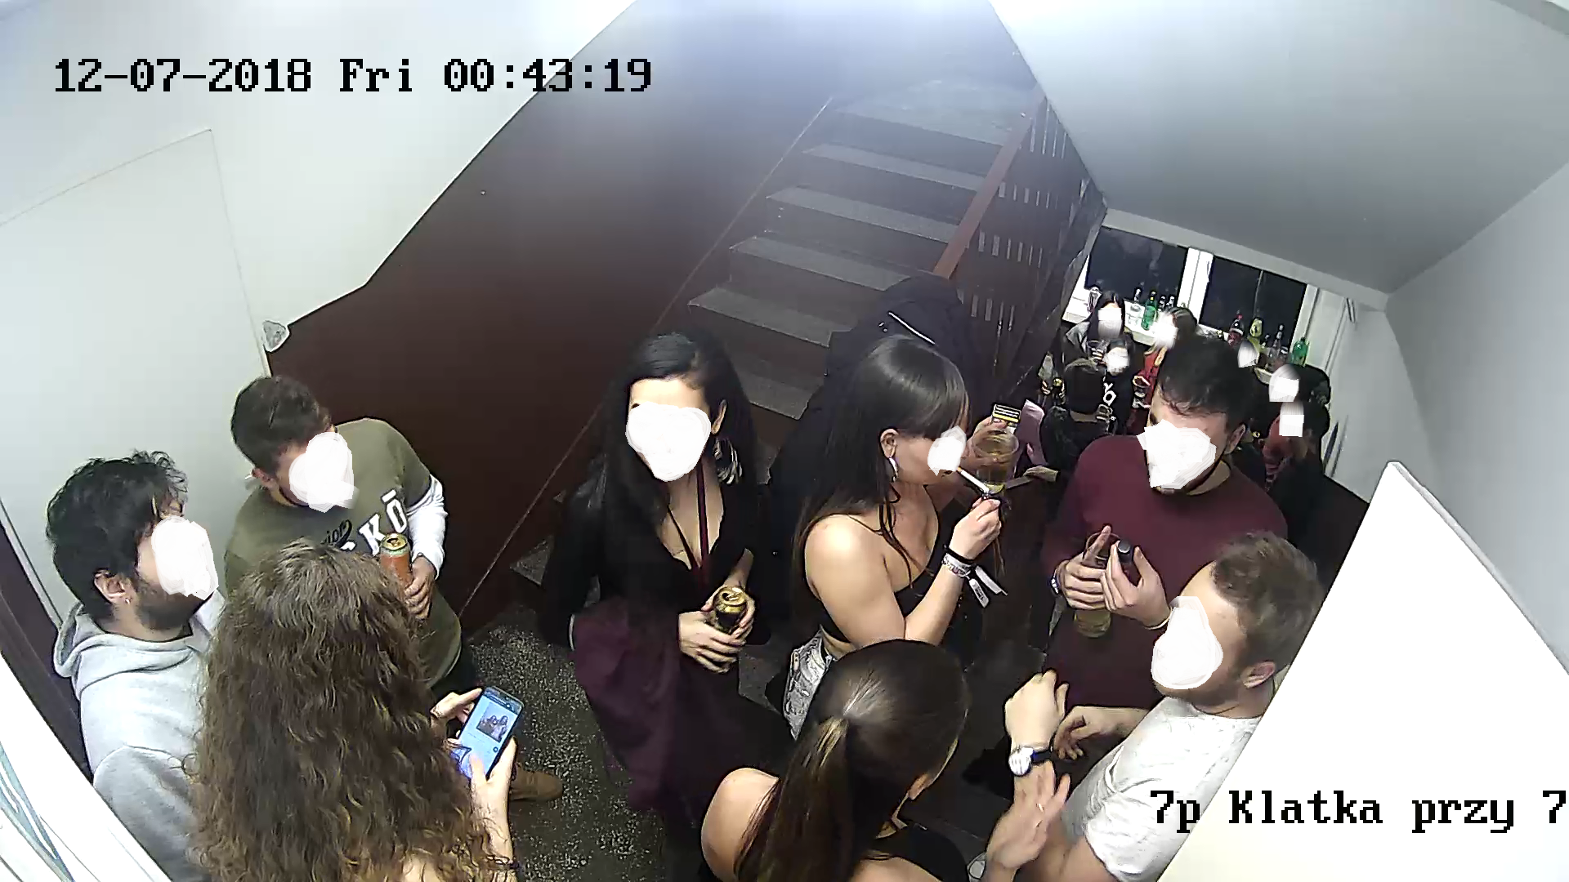
and this… - if you don’t want to lose your place in dormitory

Slide 13
Thank you for your attention

Slide 14
Important websites:
https://jsos.pwr.edu.pl/
https://edukacja.pwr.wroc.pl/
https://s.student.pwr.edu.pl/
https://prs.pwr.edu.pl/

